Slide 1

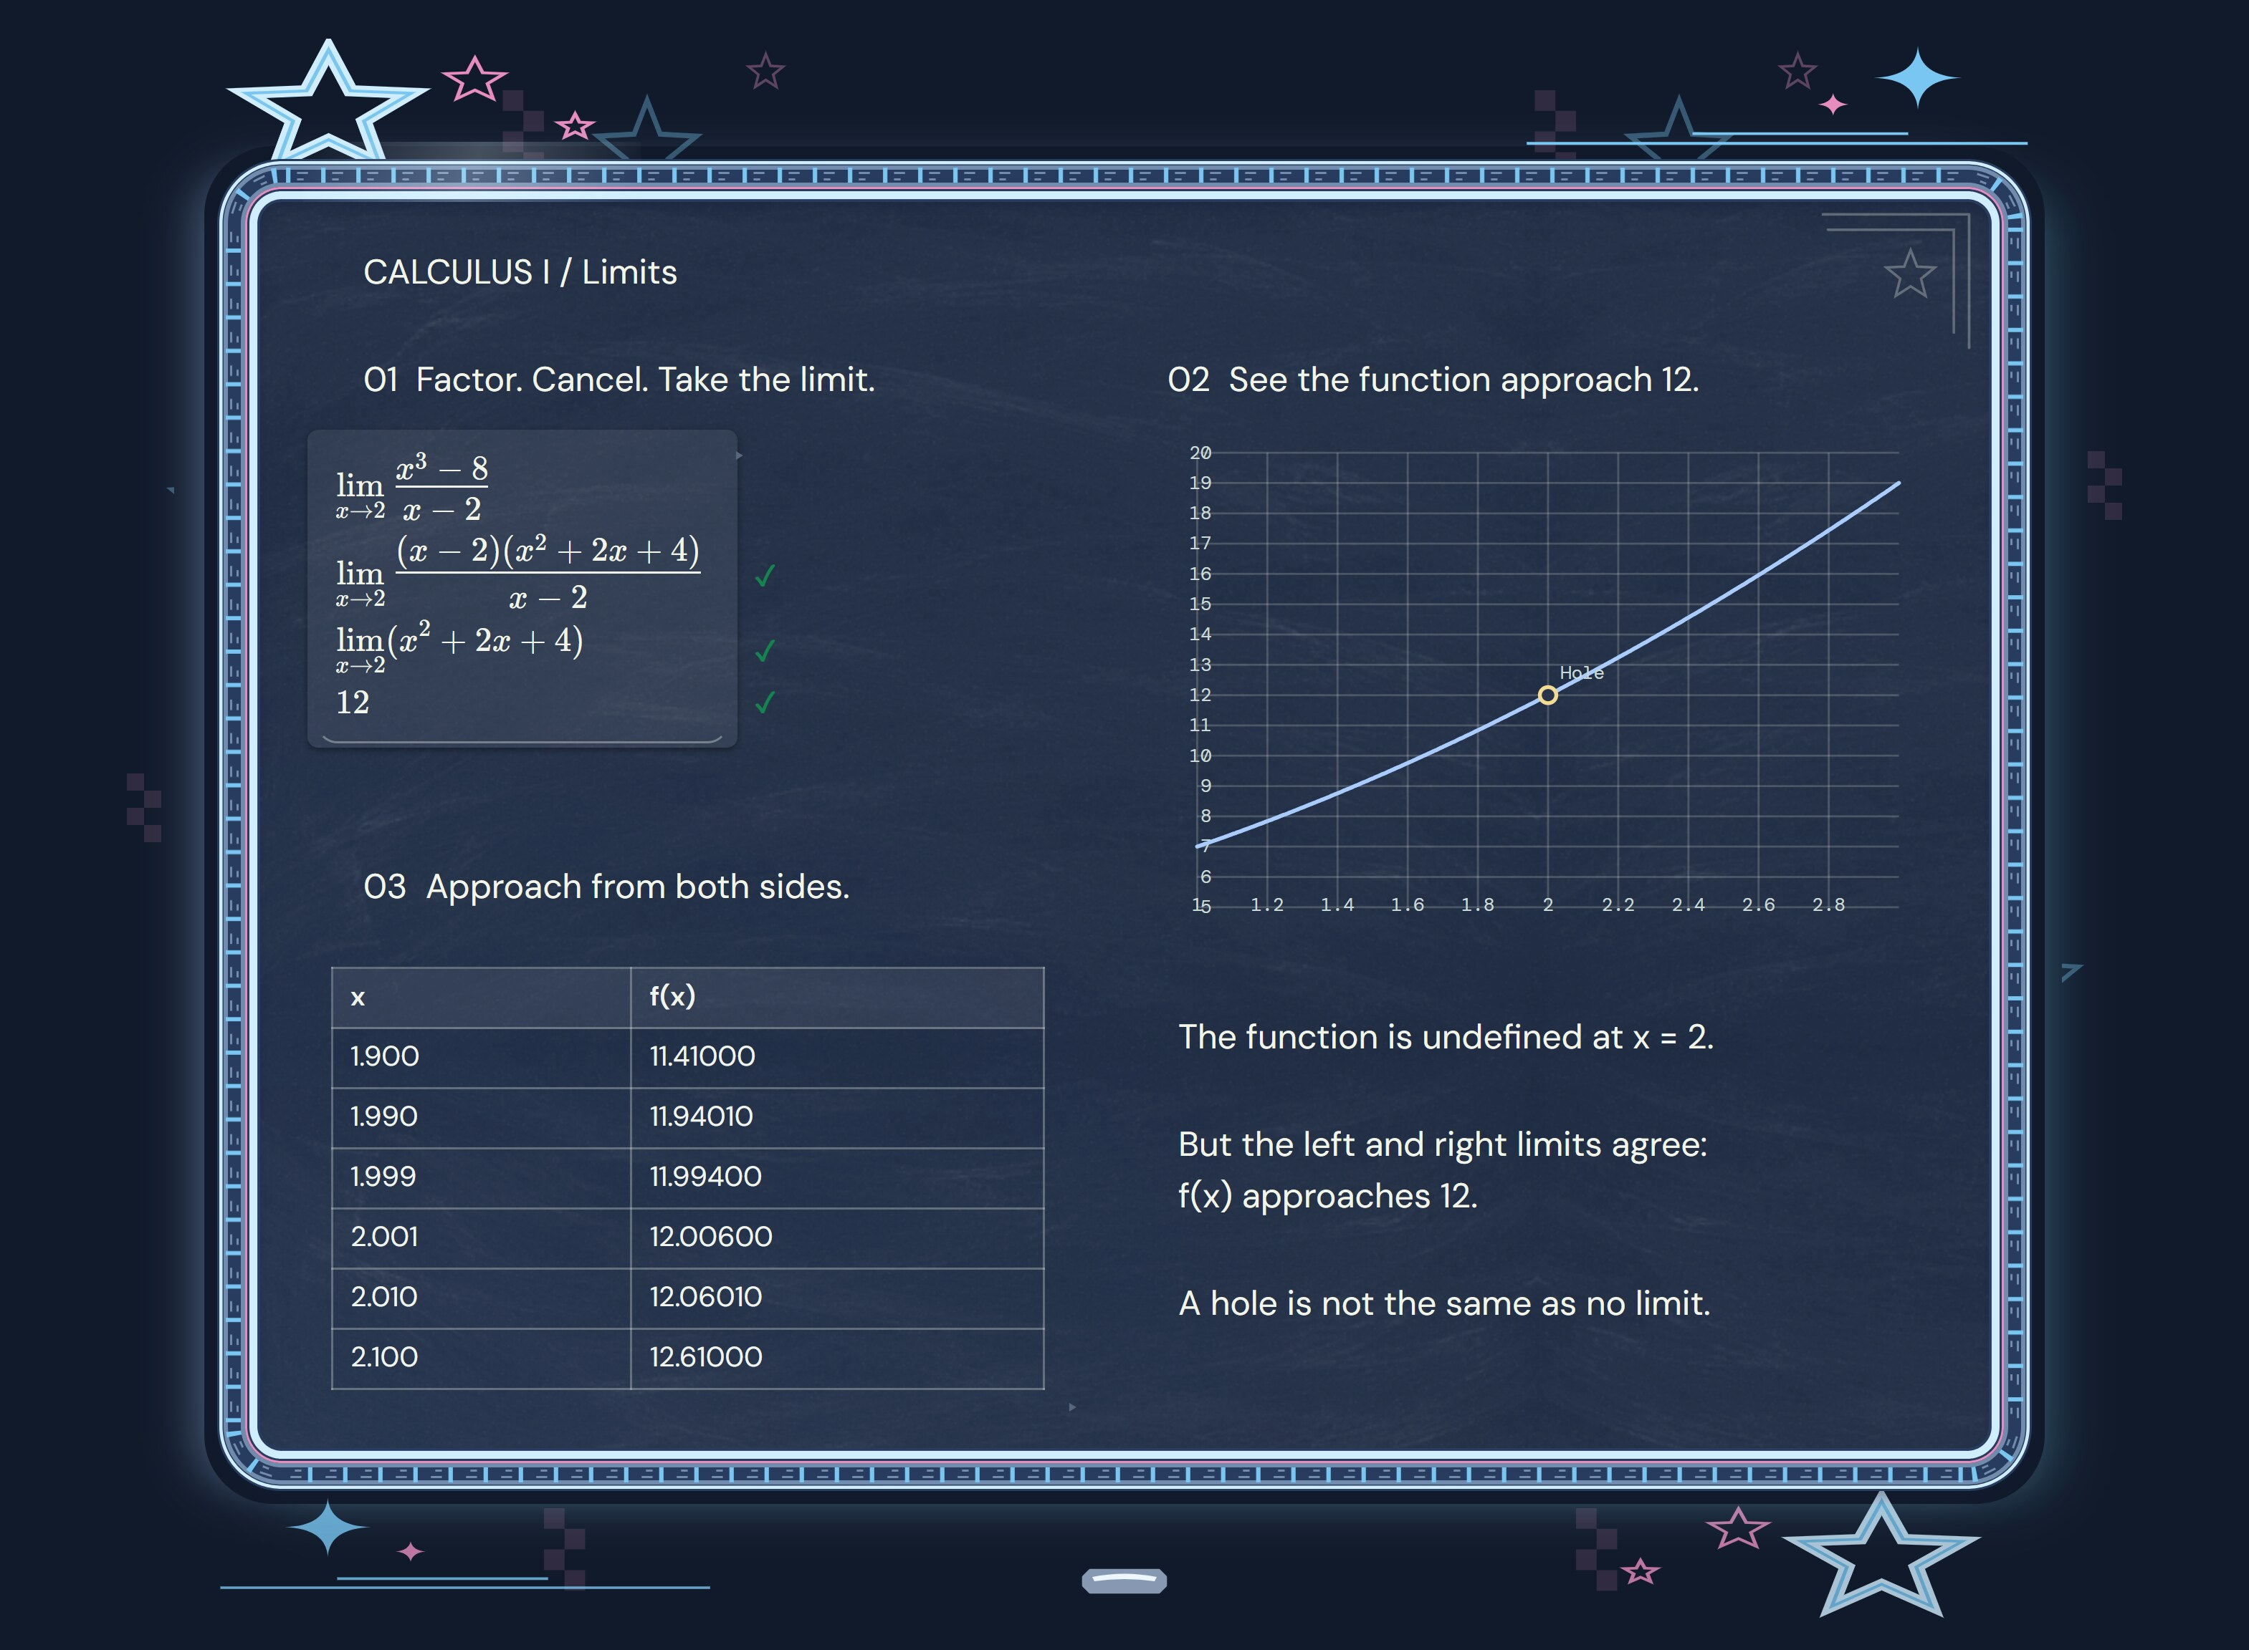
Your work.
Your world.
Chalk Inverse
Campus and digital advertising
chalkinverse.com
Notes:
Product imagery: authentic Chalk Inverse screenshots captured from the owner's V200.3 site files. Source of capabilities and catalog counts: marketing/launch-kit/college-feature-evidence.json and the application tool catalog.

Slide 2
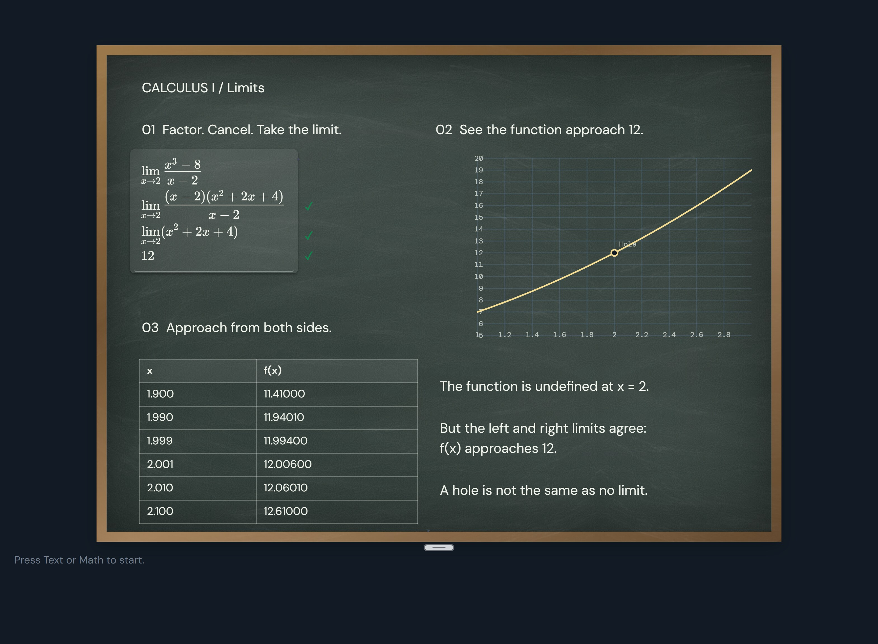
Your notebook can check your calculus
Type your steps. Check supported math. Keep the graph and table beside it.
Notes:
Product imagery: authentic Chalk Inverse screenshots captured from the owner's V200.3 site files. Source of capabilities and catalog counts: marketing/launch-kit/college-feature-evidence.json and the application tool catalog. The pictured four-row limit has three actual correct verdicts.

Slide 3
The answer is 12.
The steps matter.
A removable discontinuity, shown three ways
CHECK THE STEPS
SEE THE GRAPH
COMPARE VALUES
Factor x³ − 8.
Cancel x − 2 for x ≠ 2.
Evaluate the limit.
The curve has a hole
at (2, 12). The limit
still exists.
Approach x = 2
from both sides.
f(x) approaches 12.
The checker supports specific forms of math. It reports uncertainty when it cannot verify a step.
Chalk Inverse
03
Notes:
Product imagery: authentic Chalk Inverse screenshots captured from the owner's V200.3 site files. Source of capabilities and catalog counts: marketing/launch-kit/college-feature-evidence.json and the application tool catalog. Limit: lim x→2 (x³−8)/(x−2). Algebra valid for x≠2. Checker verdicts verified in the native app.

Slide 4
A full STEM workspace
Subject | Tools | References
Mathematics | 13 | 144 formulas
Chemistry | 22 | 332 table entries + 66 formulas
Biology | 24 | 252 reference entries
Statistics | 4 | 6 formulas
Plus a periodic table, conversion factors, drawing, diagrams, media and a linked help glossary.
Counts describe catalog tools and reference entries, including individual codons. They are not course or article counts.
Chalk Inverse
04
Notes:
Product imagery: authentic Chalk Inverse screenshots captured from the owner's V200.3 site files. Source of capabilities and catalog counts: marketing/launch-kit/college-feature-evidence.json and the application tool catalog. Math tool count includes Text, Math, Check, Graph and Table. Chemistry table entries span 37 tables. Biology references include codons and amino acids.

Slide 5

CLASSIC
Your notebook can
check your calculus.
Type your steps. Check supported math. Graph and compare.
Try your next problem.
chalkinverse.com
Notes:
Product imagery: authentic Chalk Inverse screenshots captured from the owner's V200.3 site files. Source of capabilities and catalog counts: marketing/launch-kit/college-feature-evidence.json and the application tool catalog. Theme-specific ad concept. The scene is the actual theme and named motif.

Slide 6

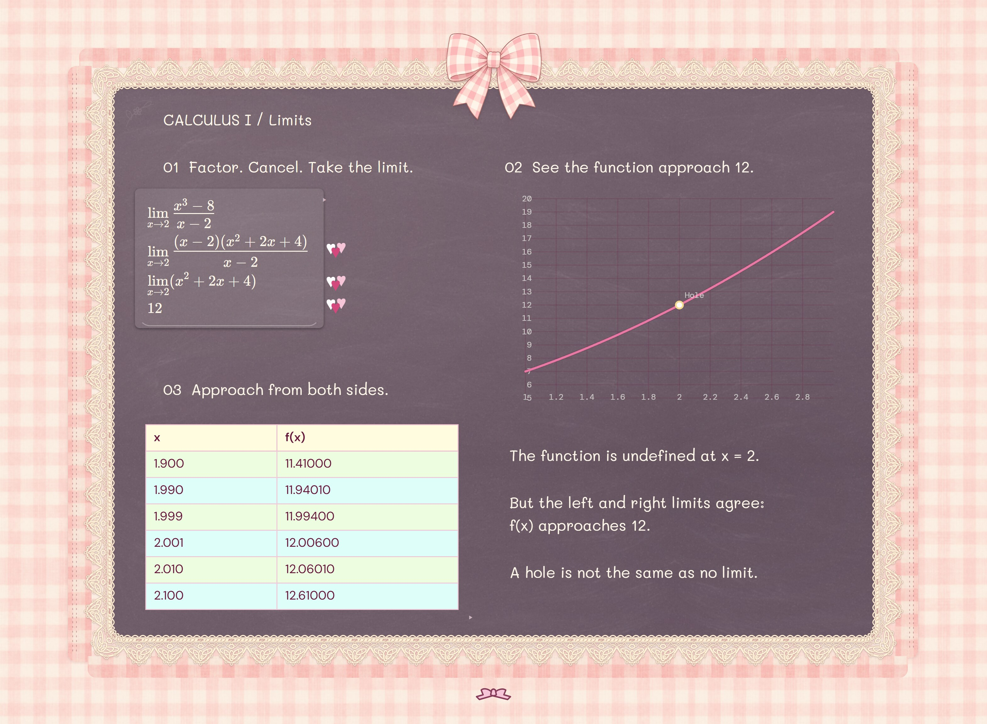
HEARTS AND BOWS / STRAWBERRY
Put calculus
in a bow.
A little lace. A worked limit. Your equations, graph and table together.
Make room for your next idea.
chalkinverse.com
Notes:
Product imagery: authentic Chalk Inverse screenshots captured from the owner's V200.3 site files. Source of capabilities and catalog counts: marketing/launch-kit/college-feature-evidence.json and the application tool catalog. Theme-specific ad concept. The scene is the actual theme and named motif.

Slide 7

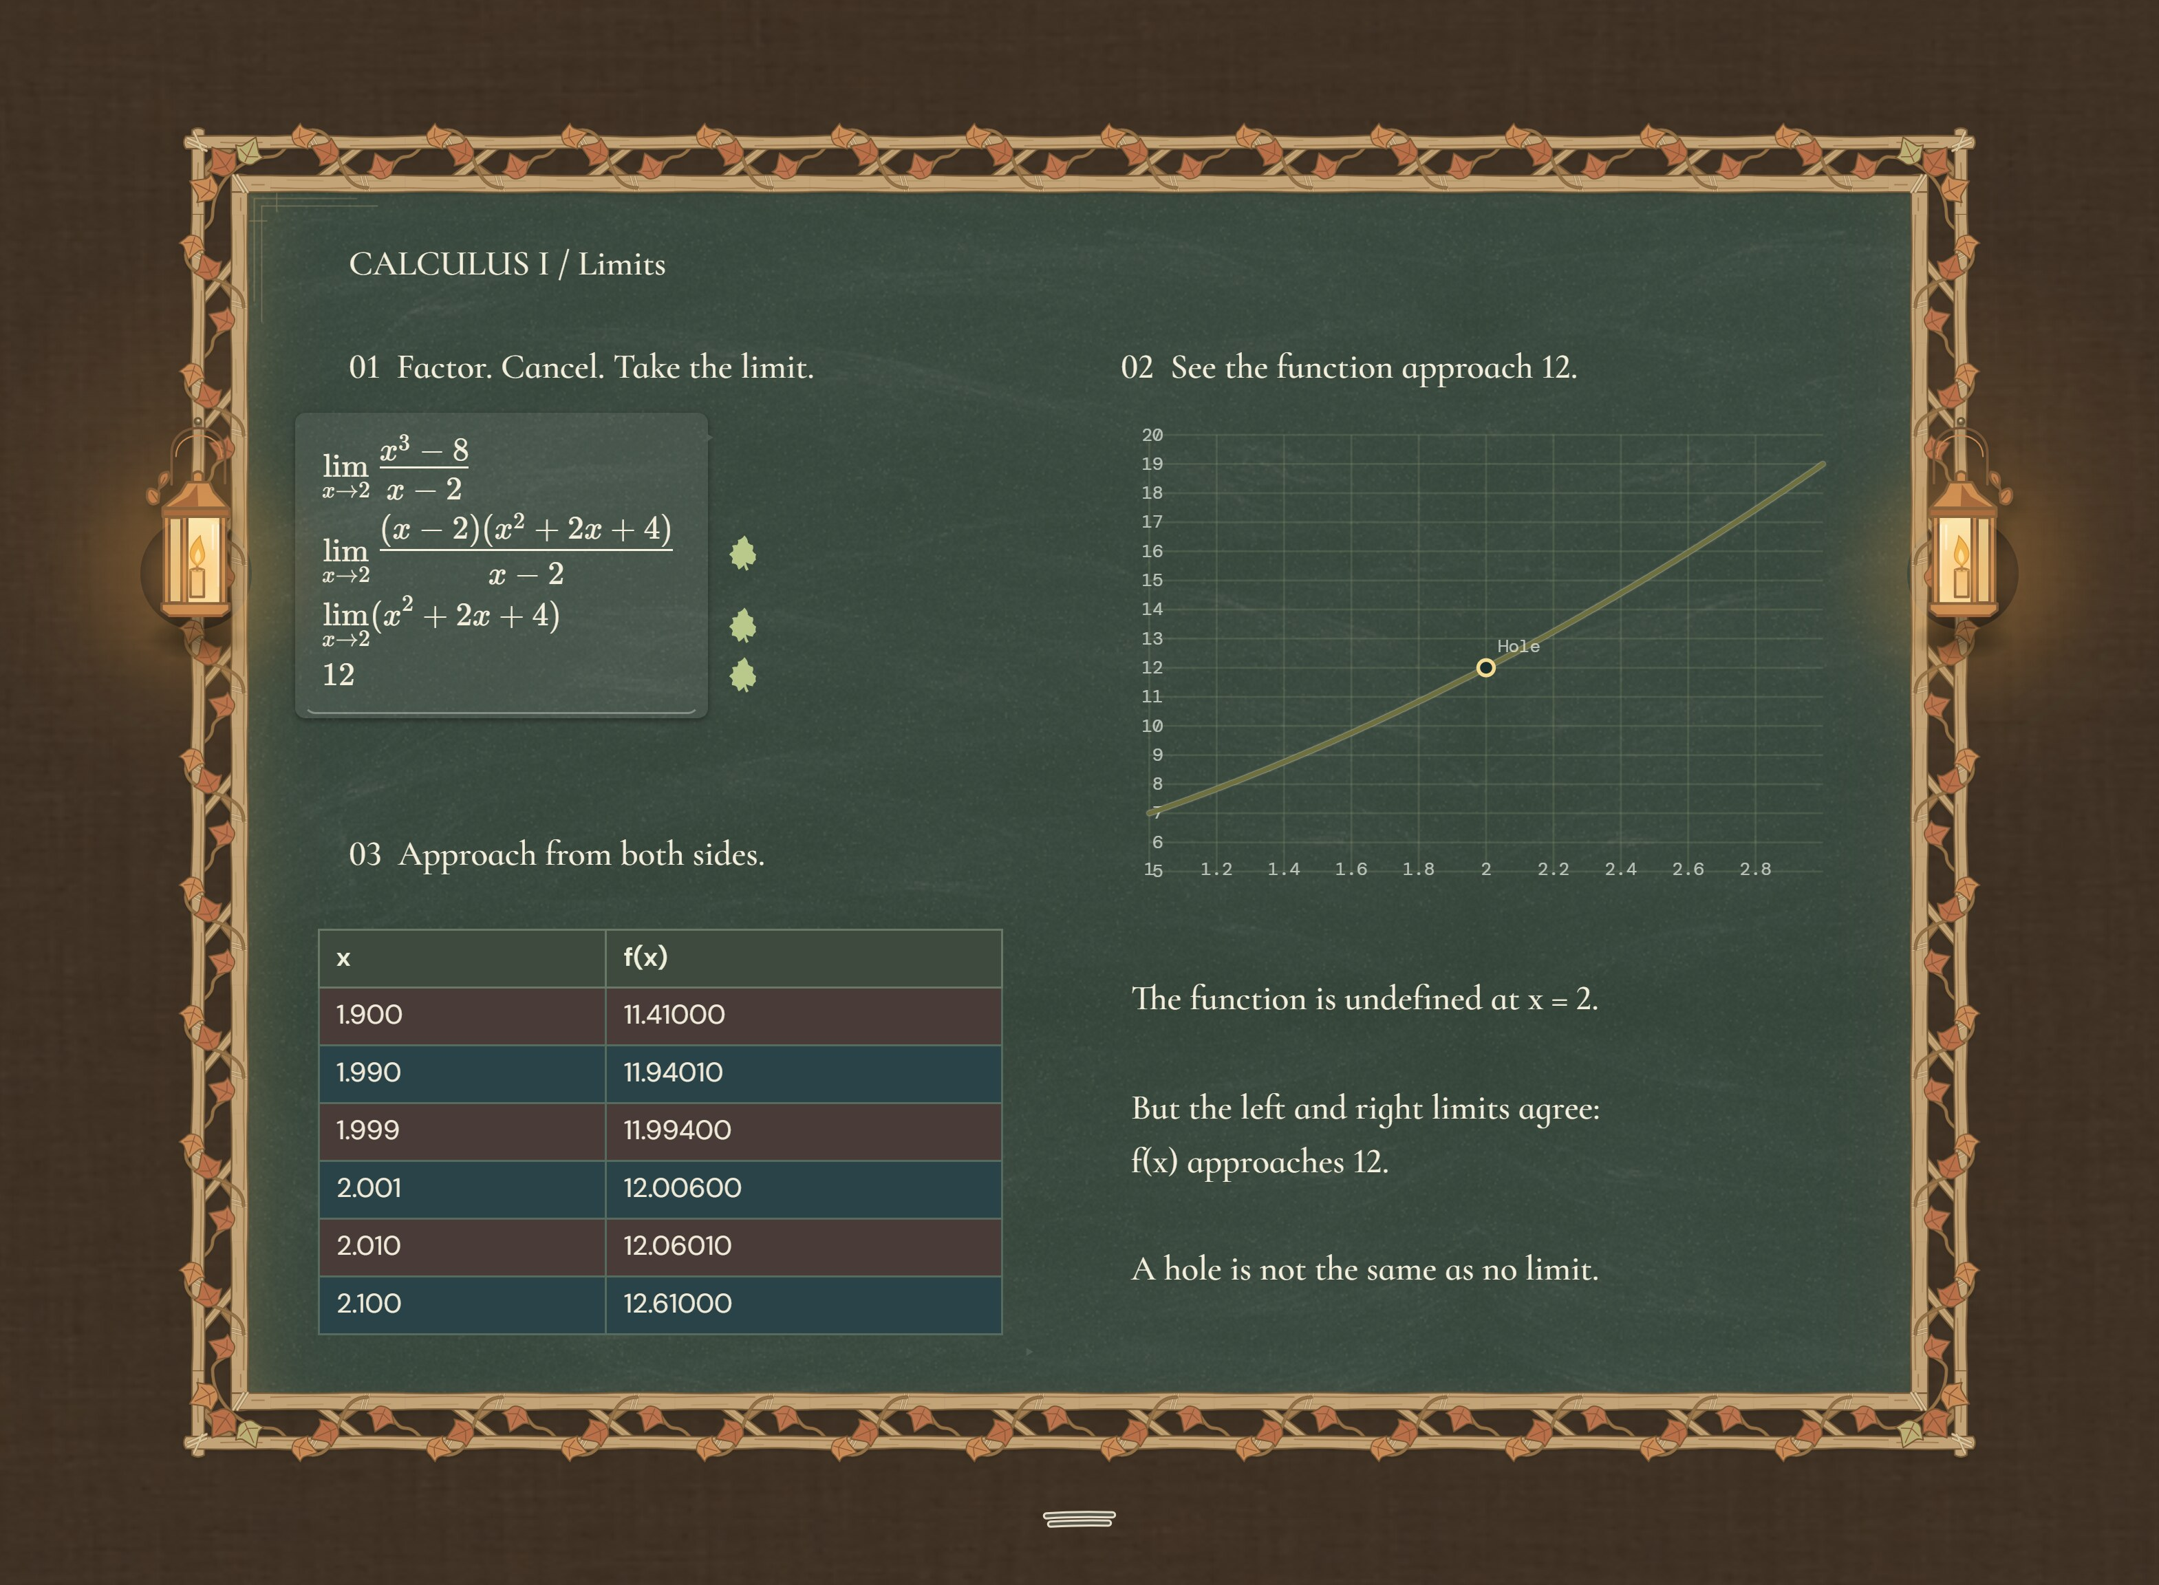
FIELD JOURNAL / AUTUMN
A field guide to
your next problem.
Follow the steps. Compare the graph. Keep your observations close.
See what you can work out.
chalkinverse.com
Notes:
Product imagery: authentic Chalk Inverse screenshots captured from the owner's V200.3 site files. Source of capabilities and catalog counts: marketing/launch-kit/college-feature-evidence.json and the application tool catalog. Theme-specific ad concept. The scene is the actual theme and named motif.

Slide 8

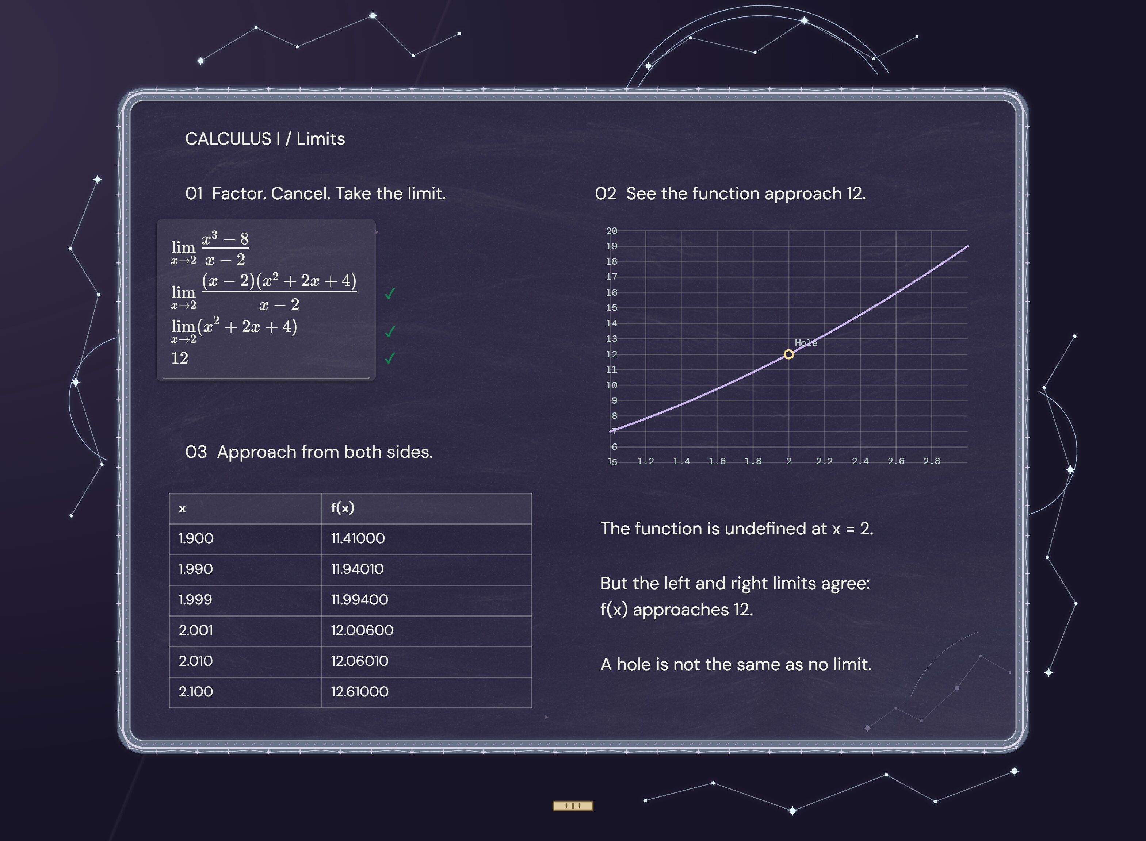
OBSERVATORY / STAR CHART
See where the
math is going.
A limit, its graph and the numbers around it. All in view.
Explore your next question.
chalkinverse.com
Notes:
Product imagery: authentic Chalk Inverse screenshots captured from the owner's V200.3 site files. Source of capabilities and catalog counts: marketing/launch-kit/college-feature-evidence.json and the application tool catalog. Theme-specific ad concept. The scene is the actual theme and named motif.

Slide 9

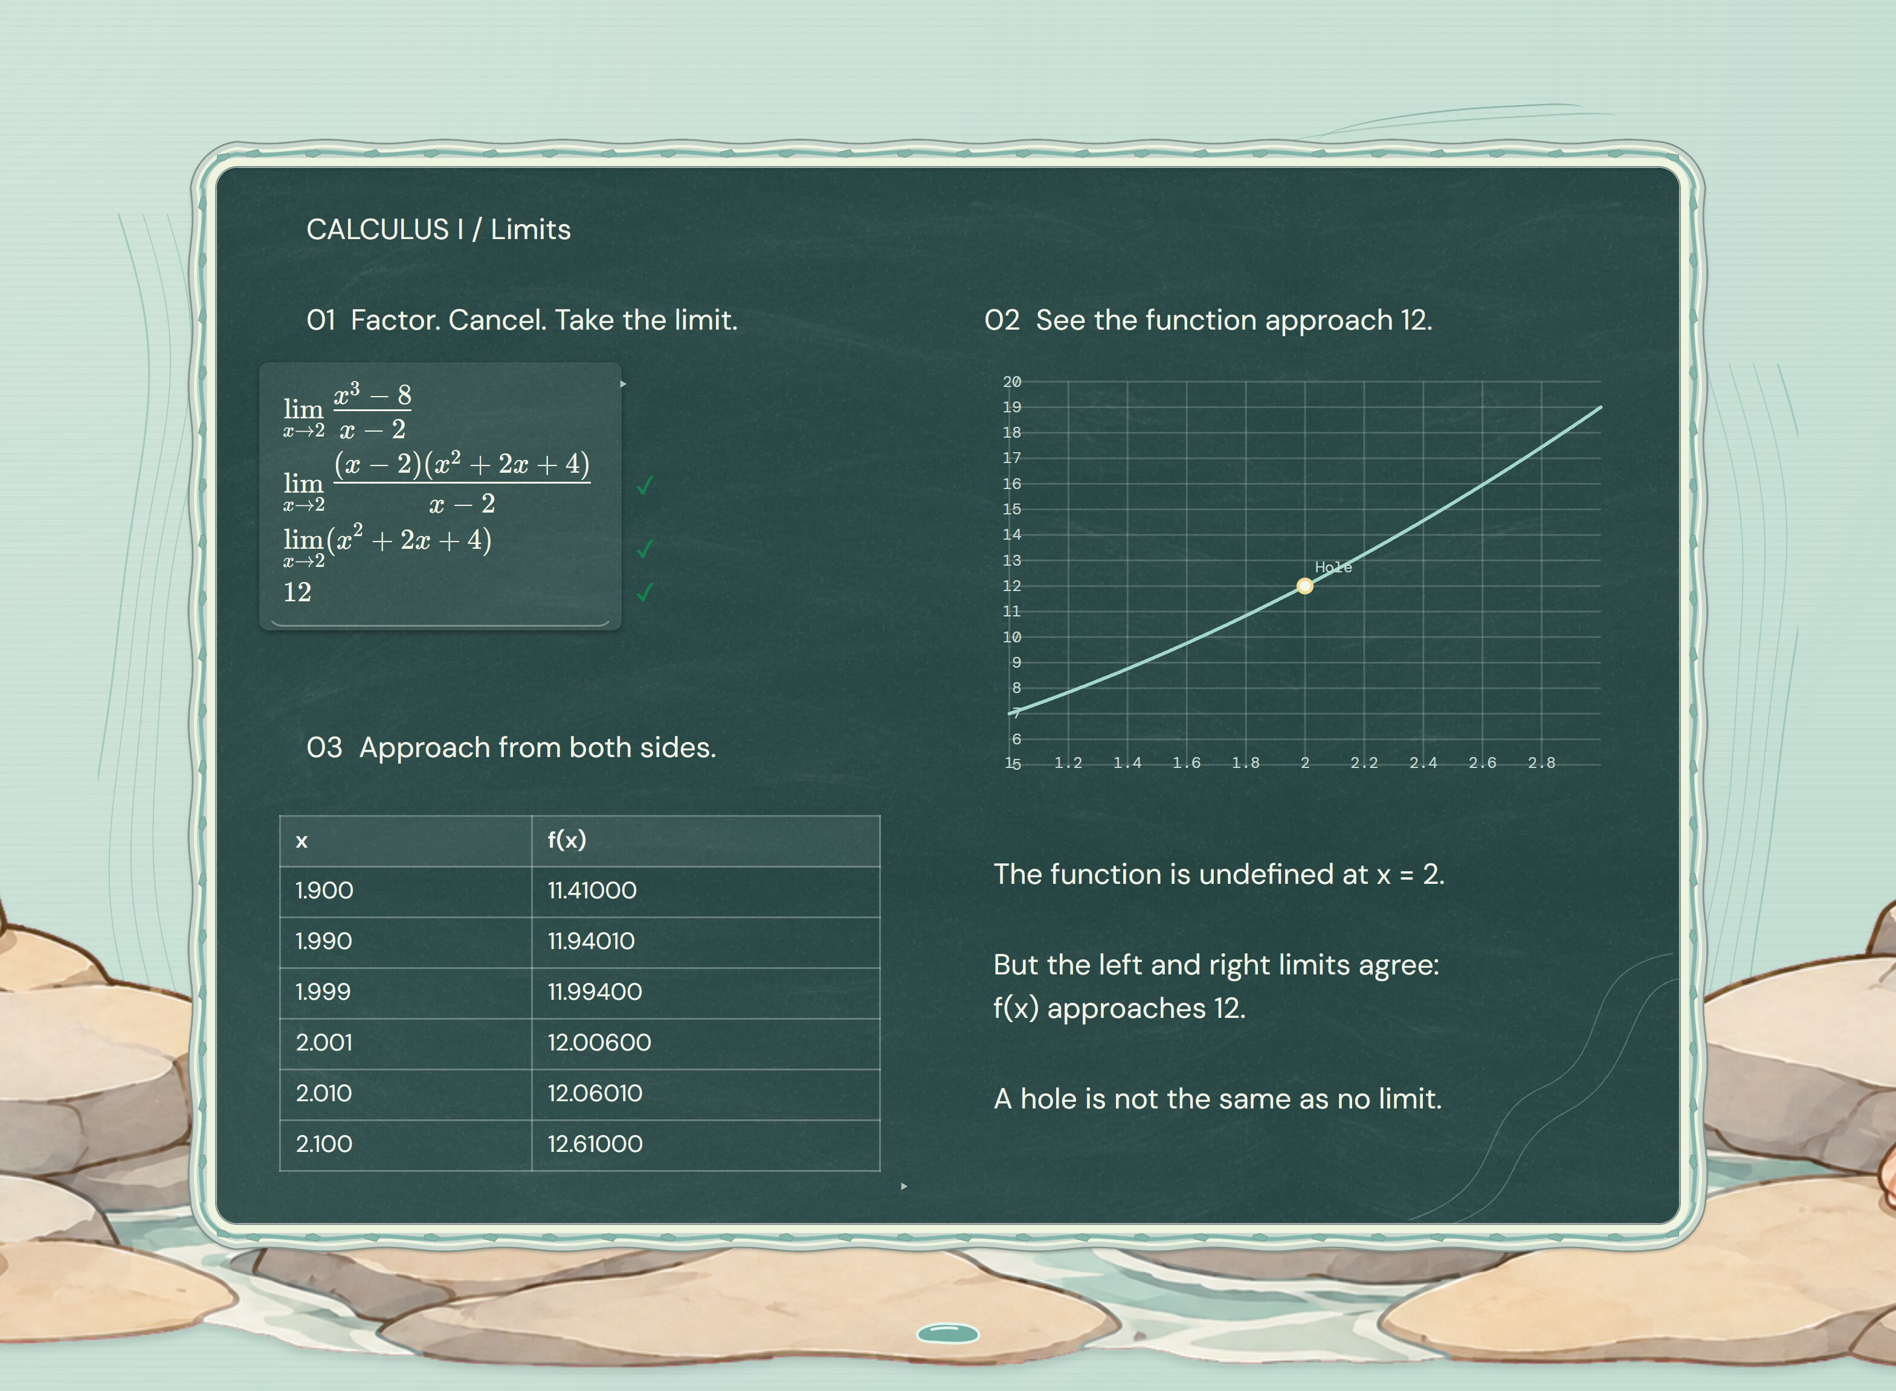
TIDEPOOL / SEA GLASS
Follow the curve.
See the limit.
Room for the algebra. Room for the graph. A shore of your own.
Take a closer look.
chalkinverse.com
Notes:
Product imagery: authentic Chalk Inverse screenshots captured from the owner's V200.3 site files. Source of capabilities and catalog counts: marketing/launch-kit/college-feature-evidence.json and the application tool catalog. Theme-specific ad concept. The scene is the actual theme and named motif.

Slide 10

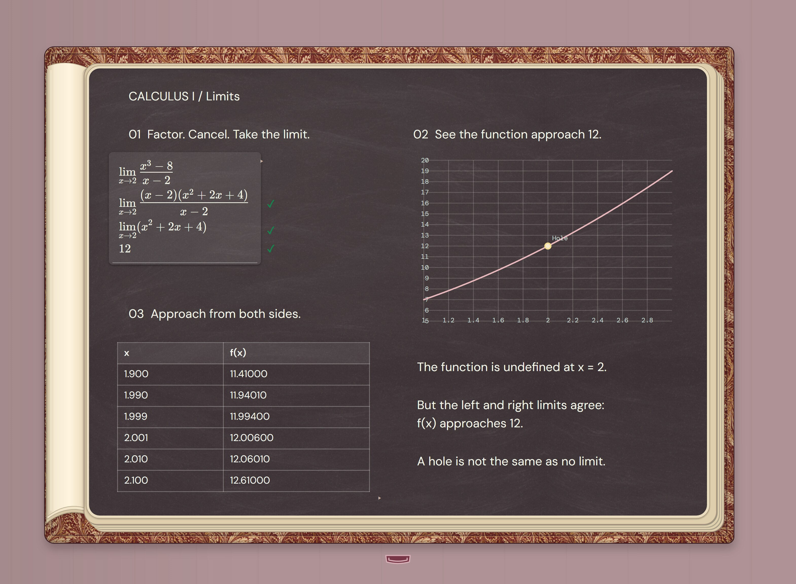
HEIRLOOM LIBRARY / OXBLOOD & IVORY
One limit.
Three ways in.
Your steps, graph and table. Bound together on your board.
Open your next chapter.
chalkinverse.com
Notes:
Product imagery: authentic Chalk Inverse screenshots captured from the owner's V200.3 site files. Source of capabilities and catalog counts: marketing/launch-kit/college-feature-evidence.json and the application tool catalog. Theme-specific ad concept. The scene is the actual theme and named motif.

Slide 11

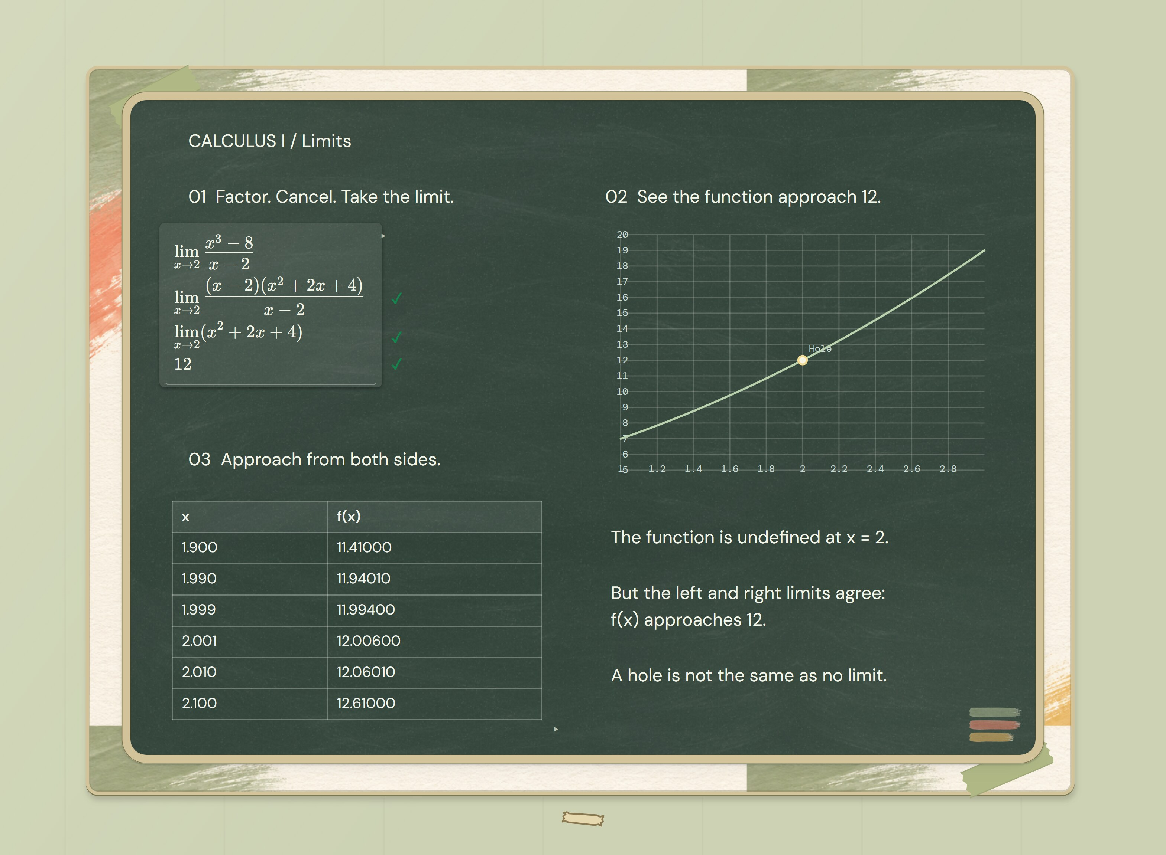
ART ROOM / GOUACHE GARDEN
Sketch the idea.
Work out the math.
Draw alongside equations. Add a graph. Give your thinking room.
Make a board worth coming back to.
chalkinverse.com
Notes:
Product imagery: authentic Chalk Inverse screenshots captured from the owner's V200.3 site files. Source of capabilities and catalog counts: marketing/launch-kit/college-feature-evidence.json and the application tool catalog. Theme-specific ad concept. The scene is the actual theme and named motif.

Slide 12

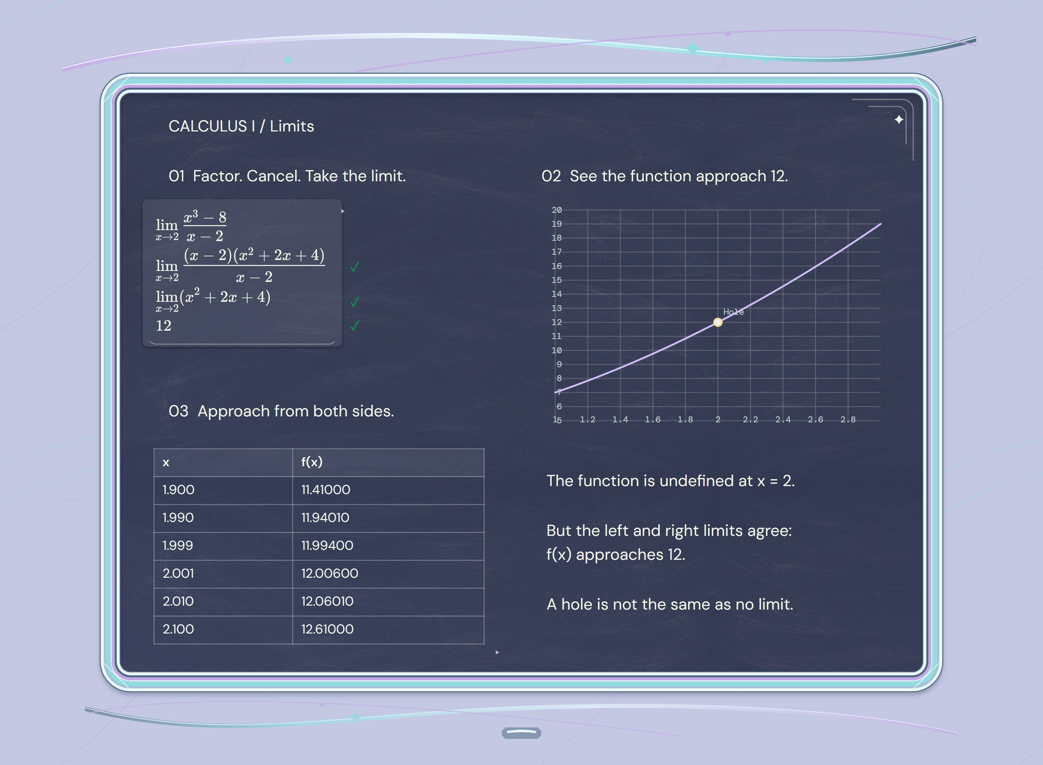
Y2K / CHROME CANDY
Make this tab
your space.
Chrome, calculus and a board you can make your own.
Open your new study space.
chalkinverse.com
Notes:
Product imagery: authentic Chalk Inverse screenshots captured from the owner's V200.3 site files. Source of capabilities and catalog counts: marketing/launch-kit/college-feature-evidence.json and the application tool catalog. Theme-specific ad concept. The scene is the actual theme and named motif.

Slide 13
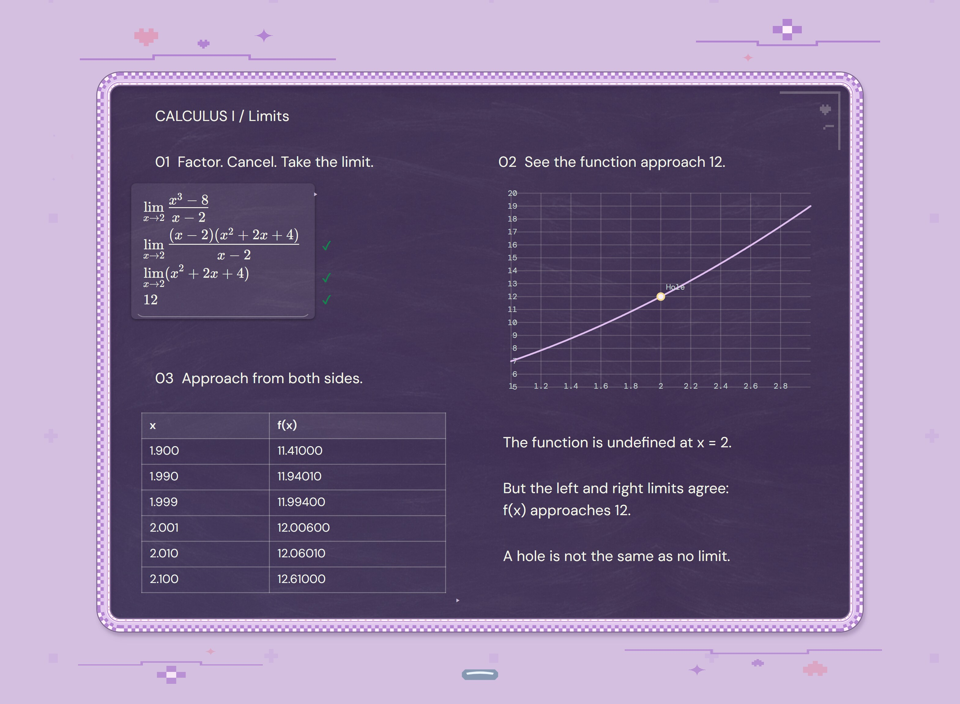
The Y2K suite
Chrome Candy
Pixel Diary
Midnight Profile
Make this tab
your space.
Your equation.
Your graph. Your page.
Your midnight
math corner.
Chalk Inverse
13
Notes:
Product imagery: authentic Chalk Inverse screenshots captured from the owner's V200.3 site files. Source of capabilities and catalog counts: marketing/launch-kit/college-feature-evidence.json and the application tool catalog. Y2K motif names: Chrome Candy, Pixel Diary, Midnight Profile.

Slide 14
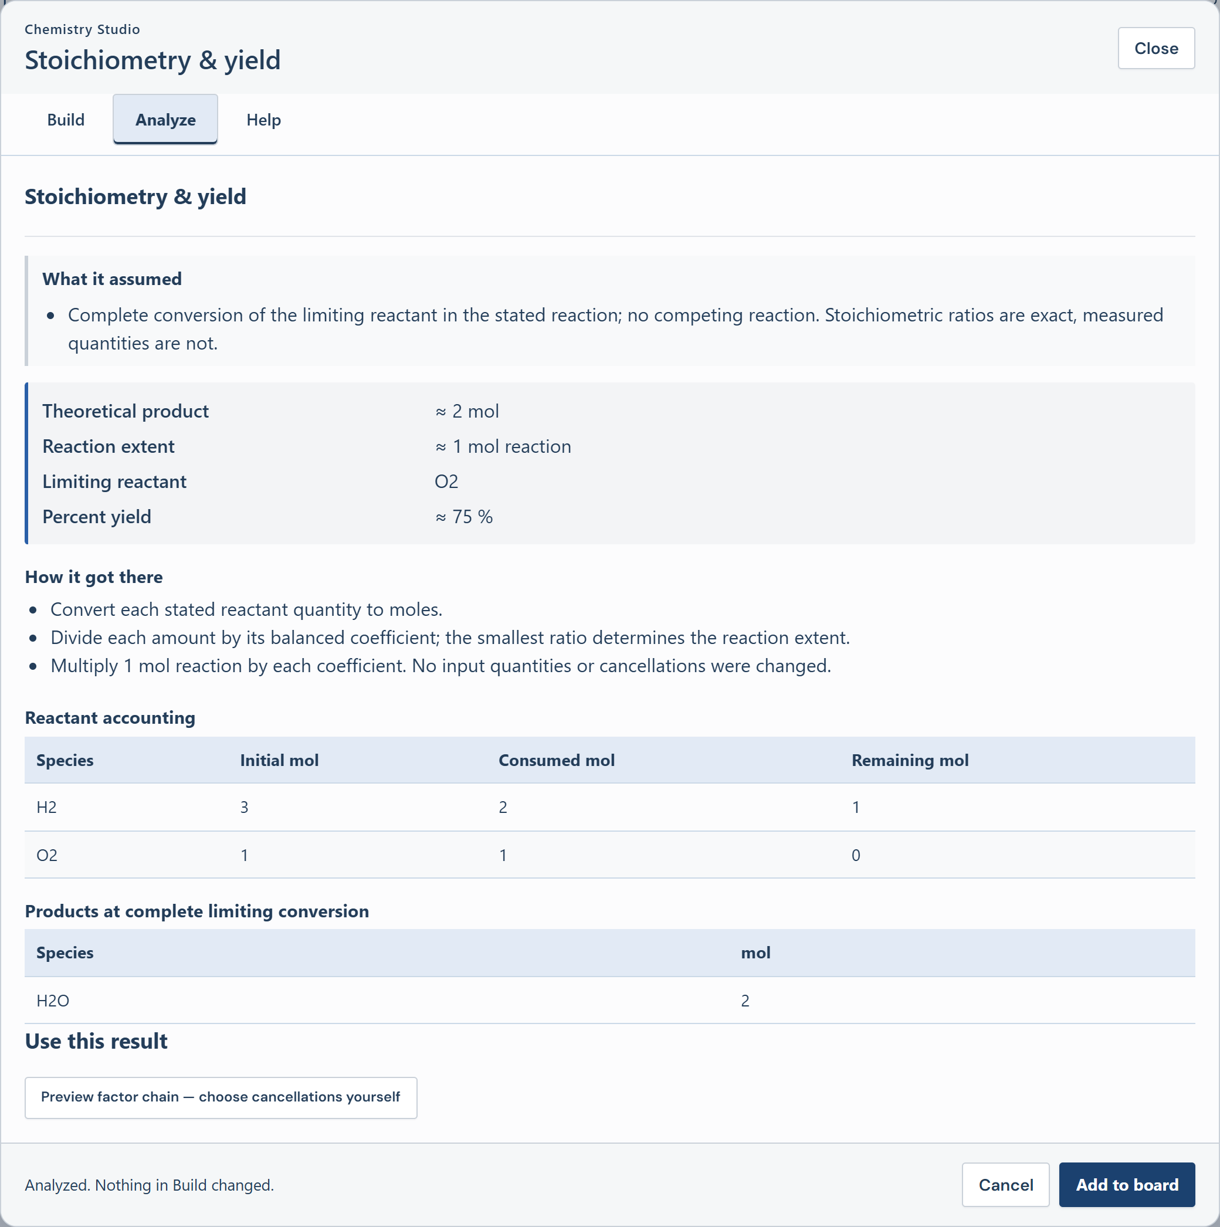
The reaction
is only the
beginning.
Find the limiting reactant.
Account for what remains.
Explore the yield.
22 tools. 37 tables. 66 formulas.
chalkinverse.com
Notes:
Product imagery: authentic Chalk Inverse screenshots captured from the owner's V200.3 site files. Source of capabilities and catalog counts: marketing/launch-kit/college-feature-evidence.json and the application tool catalog. Actual chemistry result: 3 mol H2 and 1 mol O2 produce a theoretical 2 mol H2O. O2 limits. 1.5 mol actual product gives 75% yield. Capture evidence: video/source-captures/capture-evidence.json.

Slide 15
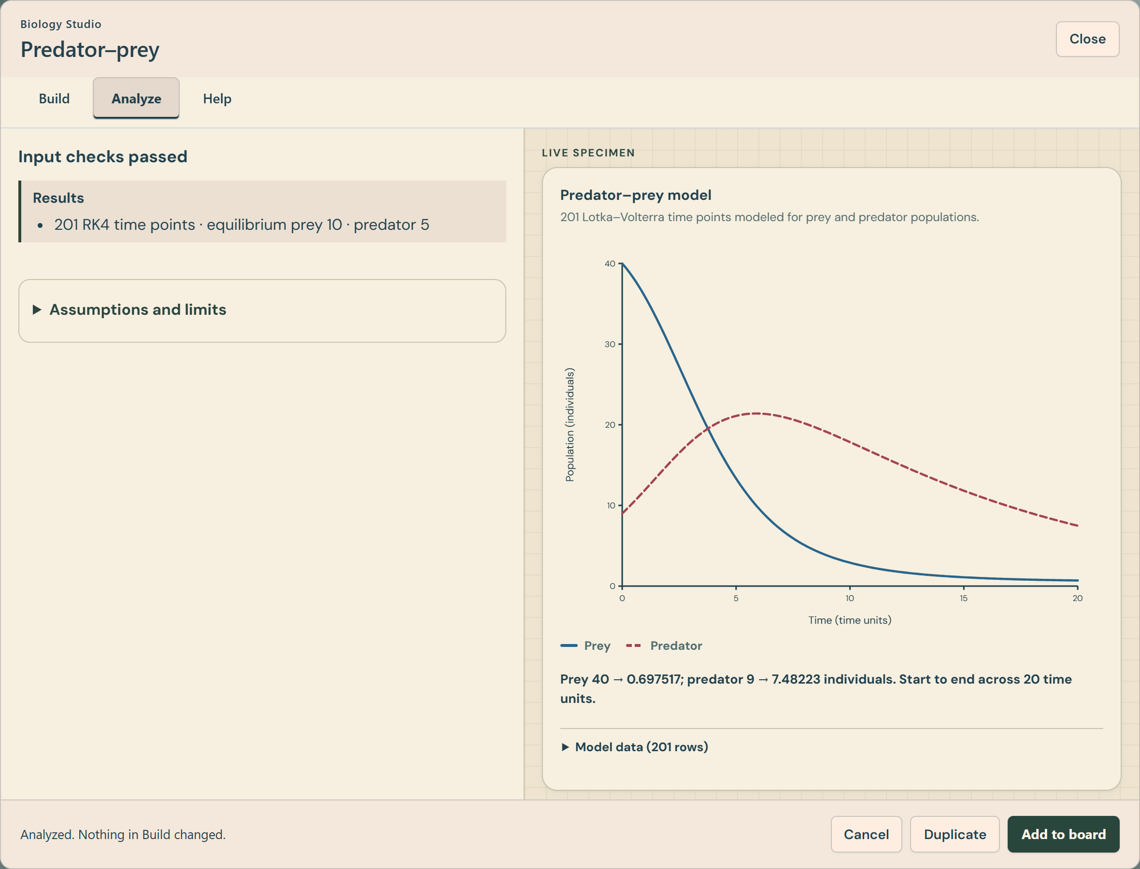
What happens
to the
population?
Change the model inputs.
Compare prey and predators
over time.
24 biology tools
252 reference entries
chalkinverse.com
Notes:
Product imagery: authentic Chalk Inverse screenshots captured from the owner's V200.3 site files. Source of capabilities and catalog counts: marketing/launch-kit/college-feature-evidence.json and the application tool catalog. Pictured result is a Lotka–Volterra model, not a forecast of a real ecosystem. Capture evidence: video/source-captures/capture-evidence.json.

Slide 16
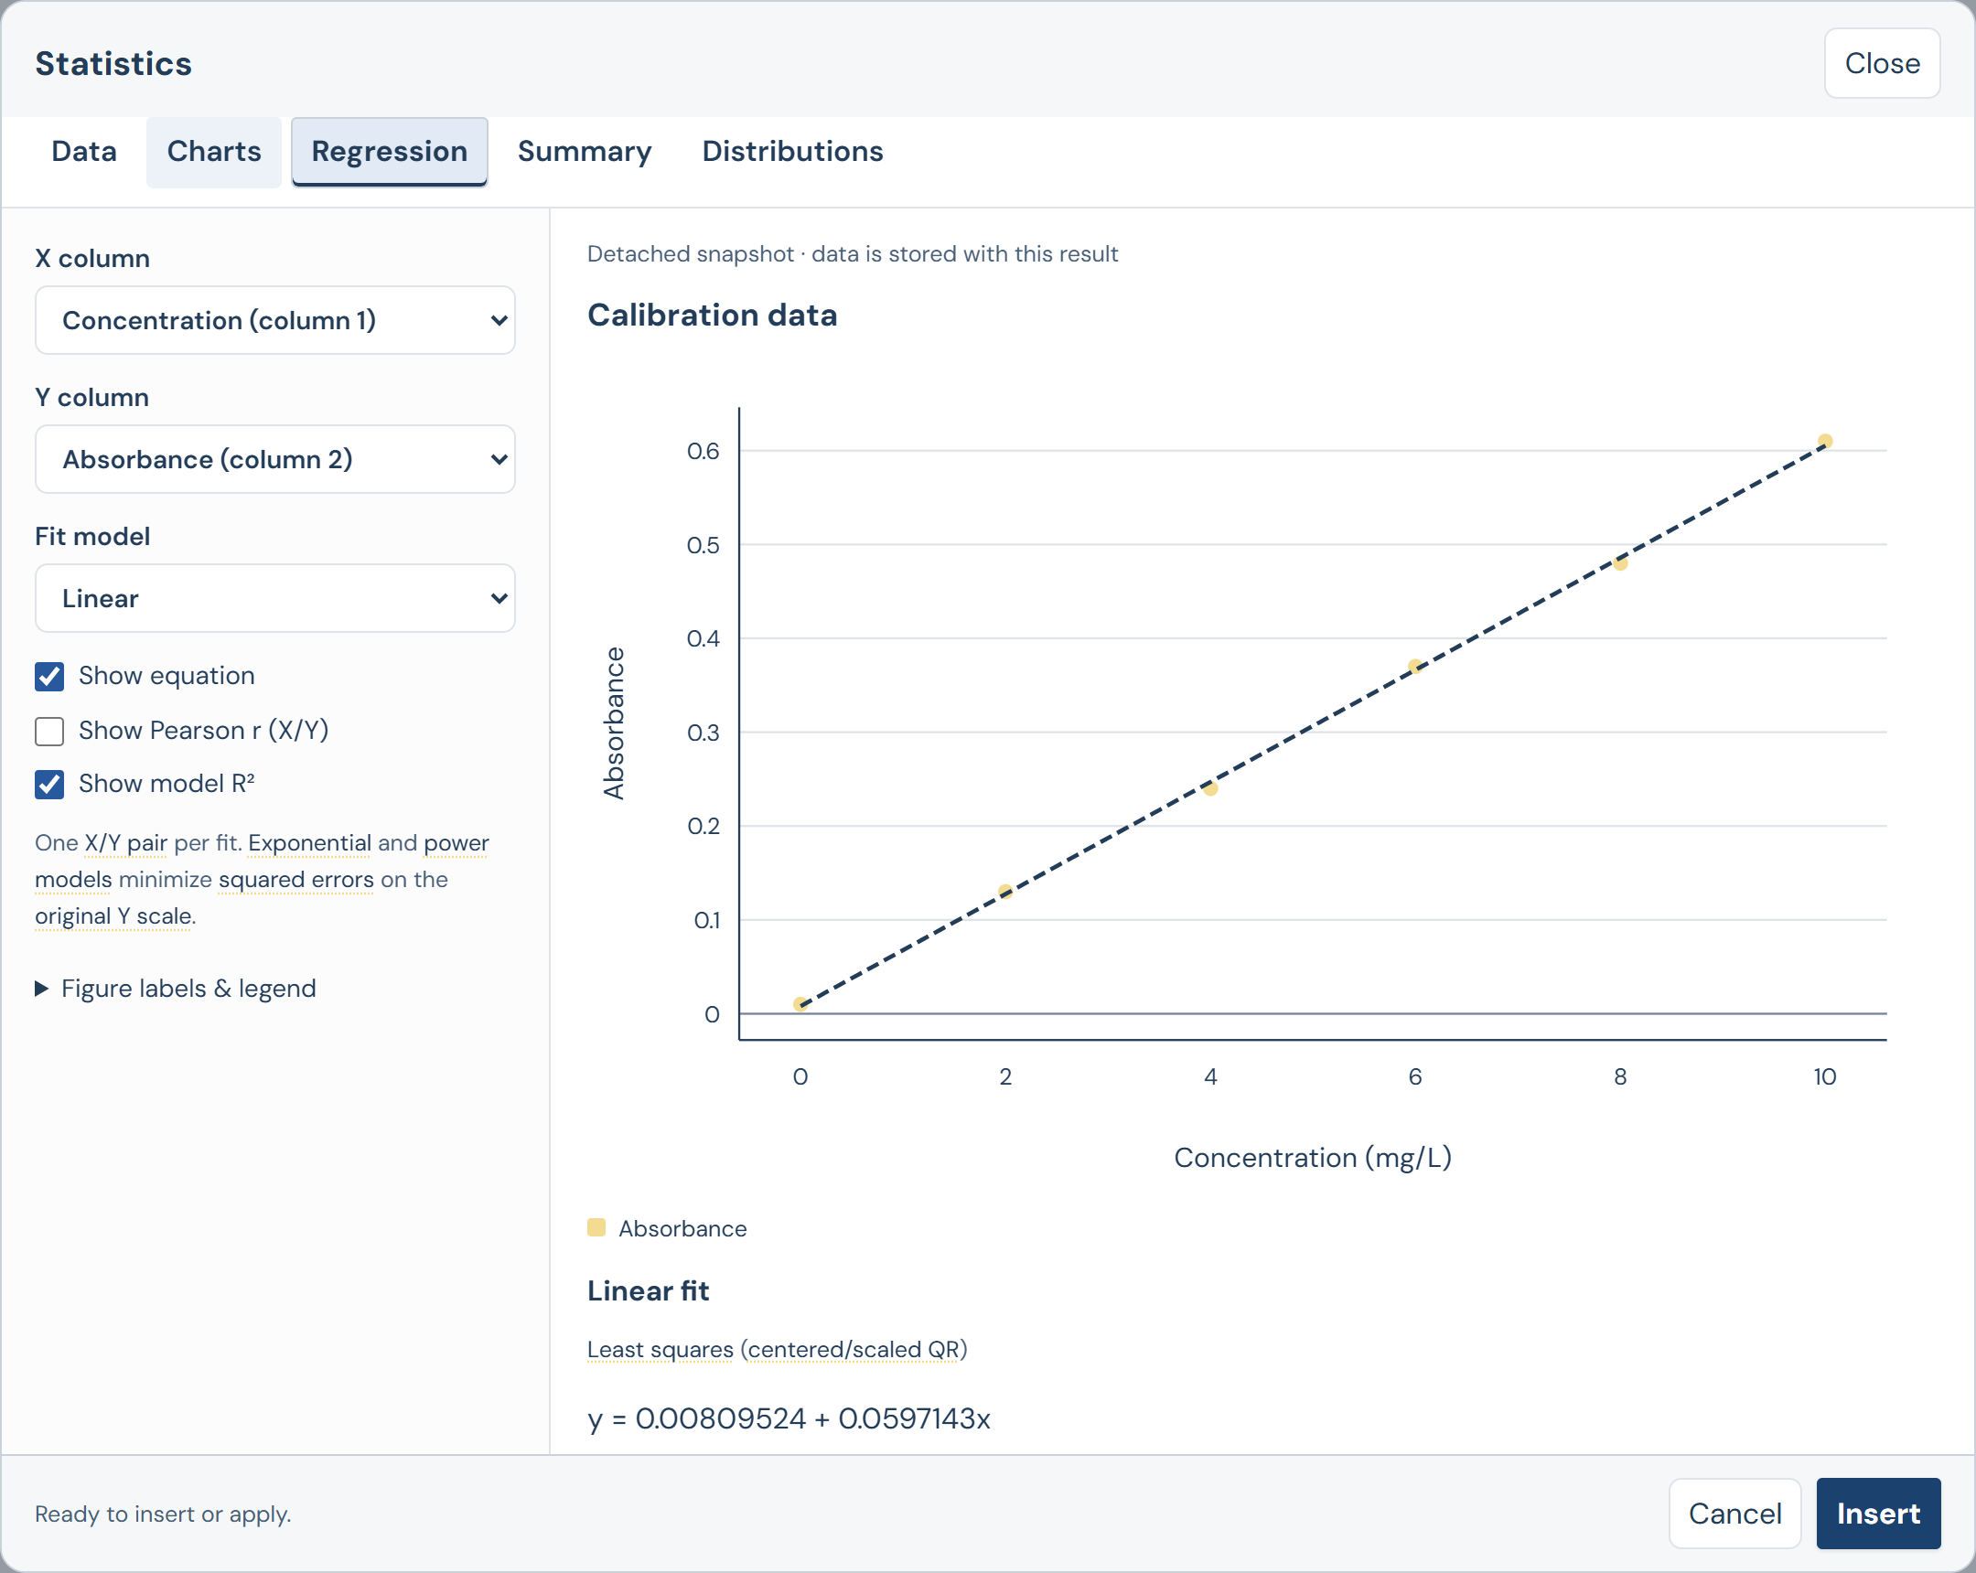
That trend
deserves a
closer look.
Fit a model. Inspect the
residuals. Keep the data
beside the graph.
4 statistics tools
6 formula references
chalkinverse.com
Notes:
Product imagery: authentic Chalk Inverse screenshots captured from the owner's V200.3 site files. Source of capabilities and catalog counts: marketing/launch-kit/college-feature-evidence.json and the application tool catalog. Calibration example uses six synthetic concentration/absorbance observations. Linear regression result y = 0.00809524 + 0.0597143x. A high R-squared does not establish model suitability. Capture evidence: video/source-captures/capture-evidence.json.

Slide 17
Campaign guide
A limit worth swiping through
Example: (x³ − 8)/(x − 2), as x approaches 2
01
02
Undefined at x = 2.
The limit still exists.
Factor the numerator.
Cancel for x ≠ 2.
03
04
Graph the hole.
Approach from both sides.
Keep all your steps.
Make the board yours.
Final frame: chalkinverse.com / Open a board. No sign-up.
Notes:
Product imagery: authentic Chalk Inverse screenshots captured from the owner's V200.3 site files. Source of capabilities and catalog counts: marketing/launch-kit/college-feature-evidence.json and the application tool catalog. Editable carousel script. Use actual checker, graph and table captures beside each statement.

Slide 18
Campaign guide
Places to meet your next users
Placement | Creative | One clear action
Campus boards | Whole-board flyer | Scan and try a problem
Study tables | Small QR card | Open a new board
Social feed | Theme ad or problem carousel | Visit chalkinverse.com
Stories and short video | Feature demonstration | Open the link
Course groups | Useful example + brief caption | Try the example yourself
Begin with a problem people recognize. Let the real workspace do the selling.
Notes:
Product imagery: authentic Chalk Inverse screenshots captured from the owner's V200.3 site files. Source of capabilities and catalog counts: marketing/launch-kit/college-feature-evidence.json and the application tool catalog. Suggested launch placements. This is a proposed use plan, not a claim that placements are approved or that paid campaigns have launched.

Slide 19

Pretty serious
about your
coursework.
Math. Chemistry. Biology. Statistics.
chalkinverse.com
A browser workspace with 8 themes.
No sign-up. Saves on your device.
Notes:
Product imagery: authentic Chalk Inverse screenshots captured from the owner's V200.3 site files. Source of capabilities and catalog counts: marketing/launch-kit/college-feature-evidence.json and the application tool catalog. Editable landscape digital ad. QR destination is https://chalkinverse.com/. Device-local saving does not imply cloud synchronization.

Slide 20

Your next problem
belongs here.
chalkinverse.com
Open a board. No sign-up.
Notes:
Product imagery: authentic Chalk Inverse screenshots captured from the owner's V200.3 site files. Source of capabilities and catalog counts: marketing/launch-kit/college-feature-evidence.json and the application tool catalog.

